Slide 1
Topic 5: DEMAND AND CONSUMER BEHAVIOR
Some slides from http://www.lancaster.ac.uk/staff/desilvad/Lecture7.pdf

Slide 2
CHAPTER OUTLINE
Choice and Utility Theory
Marginal Utility and the Law of Diminishing Marginal Utility
Relationship of Total and Marginal Utility
Derivation of Demand Curves
Why Demand Curves Slope Downward
Leisure and the Optimal Allocation of Time
Analytical Developments in Utility Theory

Slide 3
Ordinal Approach to Utility Measurement: Indifference Curve
Substitution Effect and income Effect
Substitution Effect
Income Effect
From individual to Market Demand
Demand Shifts
Substitutes and Complements
Empirical Estimates of Price and Income Elasticities
The Economics of Addiction
The Paradox of Value
Consumer Surplus
Applications of Consumer Surplus
Summary

Slide 4
Concepts
Utility measures the want-satisfying power of a good or service. Utility is the driving force for demand for commodities.
Consumer’s economic problem: Maximize utility given the income or budget constraint
Marginal utility is the additional utility due to consumption of an additional unit of a particular good. If
If Total Utility function is U = f (Qx), then dU/dQx (slope) is the marginal utility at a given point on the Total Utility curve.

Slide 5
Measurement of utility: Cardinal or Ordinal?
Cardinal measurement: In numbers, the difference between the numbers can also be measured.
Example of cardinal measurement 10, 15, 23, 45, etc.
Ordinal measurement: Higher or lower utility, only ranking of utilities possible.
If utility is cardinally measureable, it is also ordinally measureable.
If utility is ordinally measureable, it is not cardinally measuerable

Slide 6
The Law of Diminishing Marginal Utility
As the amount of a good consumed increases, the marginal utility derived from consumption of that good tends to fall. In brief, as one consumes more and more of a good, the incremental satisfaction (MU) due to additional units goes on falling. Consumers prefer variety. Instead of allocating their income to the same good, they will be attracted to buy other goods. As consumption of a commodity increase, the total utility rises but a slower and slower rate. When this rate of increase in total utility becomes zero, the total utility is maximum.

Slide 7
Relationship between Total and Marginal Utility
U = f (Qx) : for Max U,
dU/dQx = 0 (marginal utility =0) & d²U/dQx² < 0
Total utility increases at a diminishing rate
Total utility is the sum of marginal utilities
In the case of consumption of a single good, will the consumer keep on buying the commodity till the marginal utility of that good falls to zero so that s(he) maximizes utility?: NOT NECESSARILY

Slide 8
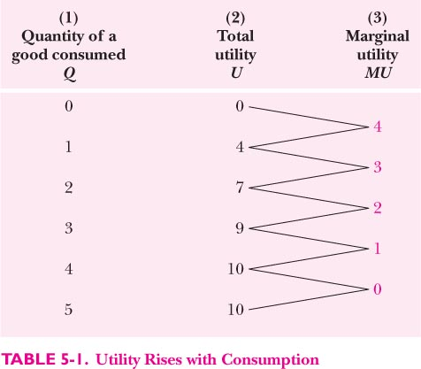
Relationship between Total and Marginal Utility

Slide 9
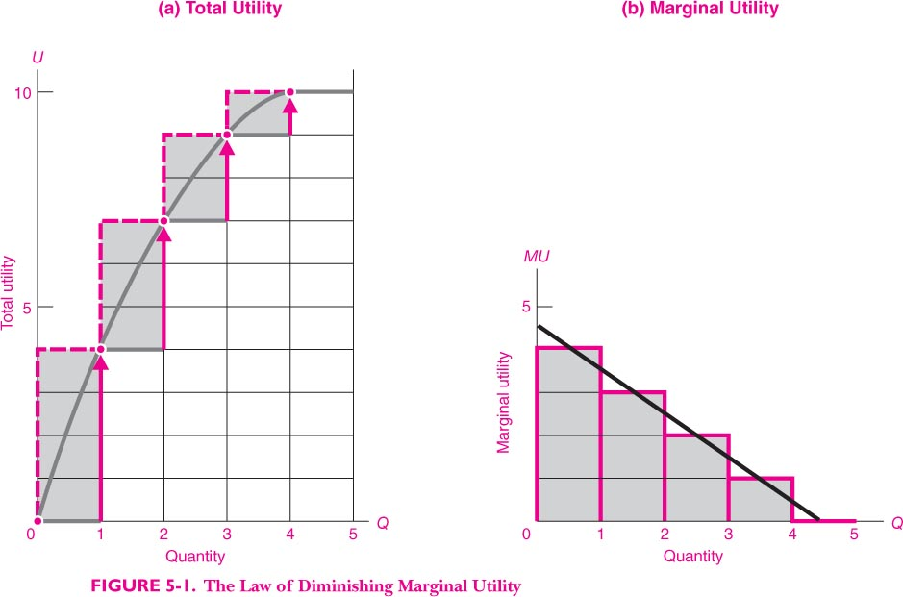
The Law of Diminishing MU

Slide 10
Consumer’s Equilibrium for one good
Consumer has to pay for the good. So s(he) will balance the benefits (extra utility) with the price of that good. S(he) will stop buying good after MUx = Px, the consumer maximizes utility subject to budget constraint. Only if the price of good = 0, i.e., the good is a free good, will the consumer be at the highest point of the total utility curve.
Assumptions: (i) Consumers are rational
(ii) Utility can be measured

Slide 11
Law of Equi-marginal Utility: Consumer’s Equilibrium with More Than One Commodity
Applied when consumer consumes more than one commodity to ascertain consumer’s equilibrium
A consumer with a given income and a given set of prices, will maximize utility when the ratio of marginal utility to price for all the goods become equal.
MUx/Px = MUy/Py = Muz/Pz = MU per unit of money

Slide 12
Convergence to Consumer’s Equilibrium
If MUx/Px >MUy/Py, then the consumer will reallocate expenditure, purchase more of ‘x’ and less of ‘y’. This is because if s(he) spends one rupee on purchase of ‘x’, he gets more utility than if it is spent on ‘y’.
If MUz/Pz <MUy/Py, then the consumer will reallocate expenditure and purchase more of ‘y’ and less of ‘z’. This is because if s(he) spends one rupee on purchase of ‘y’, he gets more utility than if it is spent on ‘z’. This reallocation of expenditure process will stop only when

Slide 13
This reallocation of expenditure process will stop only when
MUx/Px = MUy/Py = MUz/Pz = MU per unit of money
i.e, every rupee spent on different commodity gives the same utility, so that the consumer has no reason to change his/her expenditure pattern.

Slide 14
Why does the demand curve slope downwards
Law of diminishing marginal utility
One good case: Satisfaction derived from extra unit of consumption goes down and therefore, we are willing to pay a lower price for the successive units of purchases.
Multiple goods case: three goods case: x, y and z
Initial equilibrium when MUx/Px = MUy/Py = MUz/Pz
If price of x goes up, MUx/Px becomes < MUy/Py & MUz/Pz, therefore, consumer will reduce purchase of ‘x’ and increase purchase of ‘y’ and ‘z’ commodities.

Slide 15
CONSUMER SURPLUS
Willingness to pay is the maximum amount that a buyer will pay for a good.
It measures how much the buyer values the good or service. The area below the demand curve depicts the various quantities that buyer(s) would be willing and able to purchase at different prices.
Actual Payment = P*Q
Consumer surplus is the buyer’s willingness to pay for a good minus the amount the buyer actually pays for it.

Slide 16
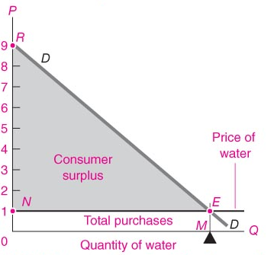
Consumer Surplus for an Individual/ Market
The demand curve depicts the various quantities that buyer(s ) would be willing and able to purchase at different prices.
& MU

Slide 17
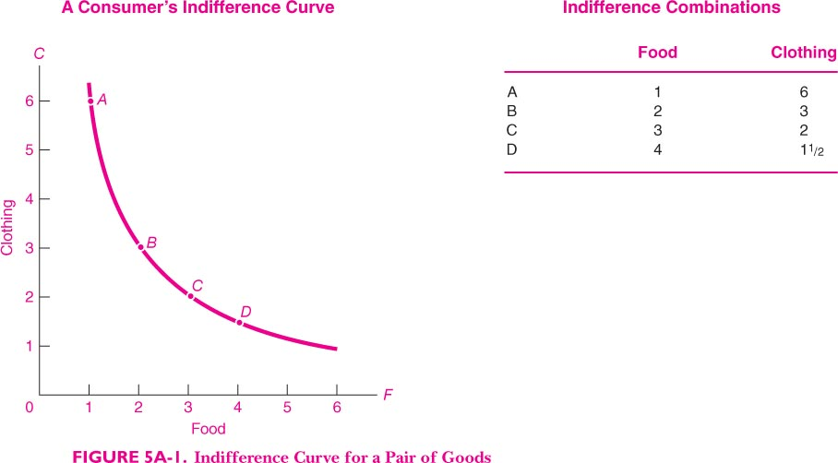
Ordinal measurement of Utility and Consumer Equilibrium
Indifference Curve is the loci of points that give equal satisfaction (iso utility curve) to the consumer. If we measure quantities of two goods X and Y on the two axis then an IC indicates combinations of goods X and Y which give equal satisfaction to a consumer.

Slide 18
Properties of Indifference curves:
Downward sloping: When more of a commodity is always preferred, the commodity is a good. If every commodity is a good then indifference curves are negatively sloped. If less of a commodity is always preferred then the commodity is a bad.
Well-Behaved Preferences: A preference relation is “well-behaved” if it is monotonic and convex.
Monotonicity: More of any commodity is always preferred (i.e. no satiation and every commodity is a good). Do not intersect each other.
Convex to origin (imperfect Substitutes)
L shaped: perfect complementary goods
Linear: perfect substitutes

Slide 19
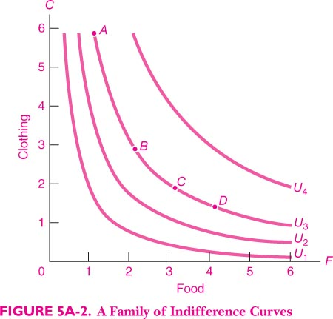
Family (MAP) of Indifference Curves
Indifference Map is a set of indifference curves.

Slide 20
Marginal rate of substitution (MRS).
Marginal rate of substitution (MRS): slope of IC-willingness of the consumer to sacrifice amount of good Y for an additional unit of good X. We ignore the negative sign of MRS.
Diminishing MRS and imperfect substitution of the goods (leads to convex ICs), as more of a good is consumed, is an important characteristic of consumer preferences.

Slide 21
Preferences and Location of ICs
Fig 1: Stronger pref for Y
Fig 2: Stronger pref for X

Slide 22
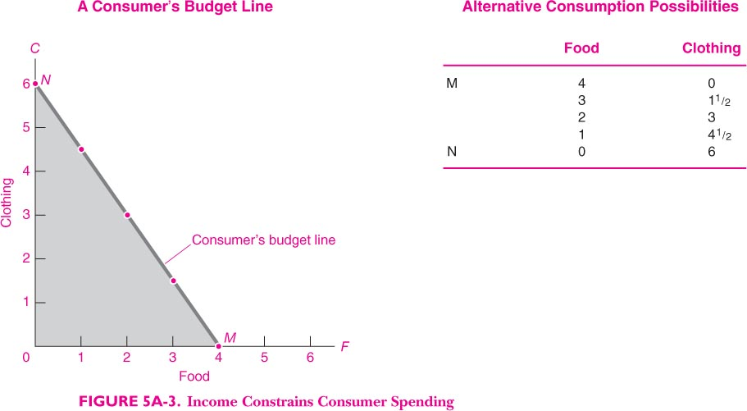
Budget Constraint
Budget constraint (price Line): I = PxQx + PyQy
Consumer spends all income on the purchases of the two goods.
Slope of price line: -Px/Py Shifts in price line due to change in Py, Px and I

Slide 23
Budget Line (Px = 1, Py = 2, I = 40 )
Goods Basket | Qx | Qy | Income spent
A | 0 | 20 | 40
B | 10 | 15 | 40
C | 20 | 10 | 40
D | 30 | 5 | 40
E | 40 | 0 | 40

Slide 24
Shifts in Budget line
Change in Money Income (I): Constant Py and Px
Increase in money income: Parallel rightward shift
Decrease in money income: Parallel leftward shift
Change in Price of X (Px): Py and I constant
Increase in Px reduces the X intercept
Decrease in Px increases the X intercept
Change in Price of X (Px): Py and I constant
Increase in Px reduces the X intercept
Decrease in Px increases the X intercept

Slide 25
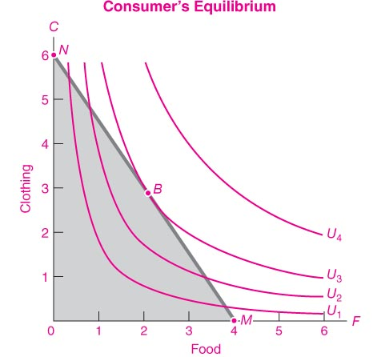
Consumer’s Equilibrium
Slope of IC (MRSx-y) = Slope of Budget Line (-Px/Py)

Slide 26
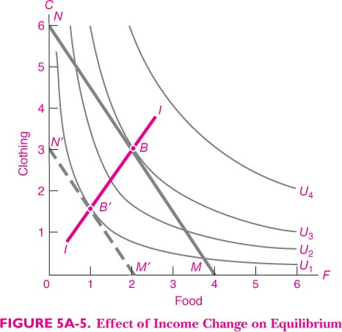
Income Effect
Income effects describe the fact that as money income of the consumers changes, prices remaining the same, there is a parellel shift in the budget line. An increase (decrease) in money income will cause a parellel outward (inward) shift in the budget line.
Initial equilibrium is at B, new equilibrium when money income of the consumer falls is at B’. II is income consumption curve.

Slide 27
Price Effect decomposition
Price Effect = Substitution Effect + Income effect
Two methods of decomposition
Hicksian Method (John R. Hicks)
Slutsky Method

Slide 28
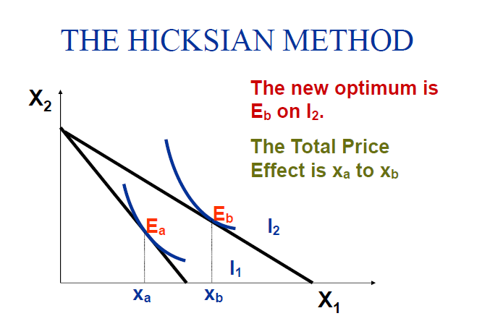
Price Effect

Slide 29
THE HICKSIAN METHOD
To isolate the substitution effect we ask….
“what would the consumer’s optimal bundle be if s/he faced the new lower price for X1 but experienced no change in real income?”
This amounts to returning the consumer to the original indifference curve (I₁)

Slide 30
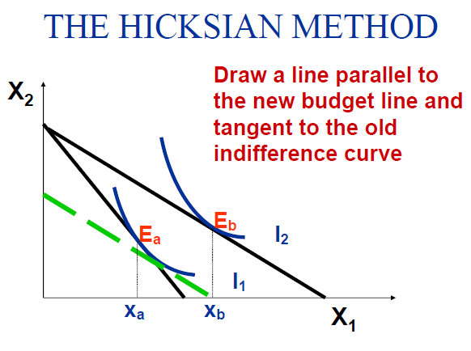
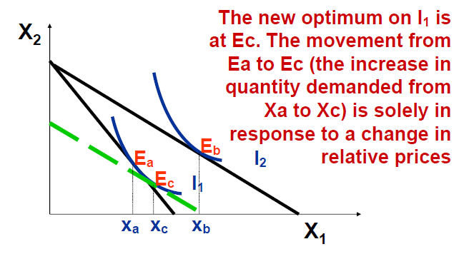

Slide 31
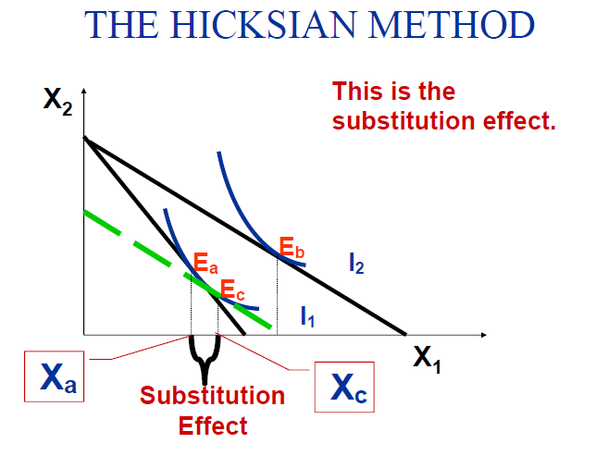
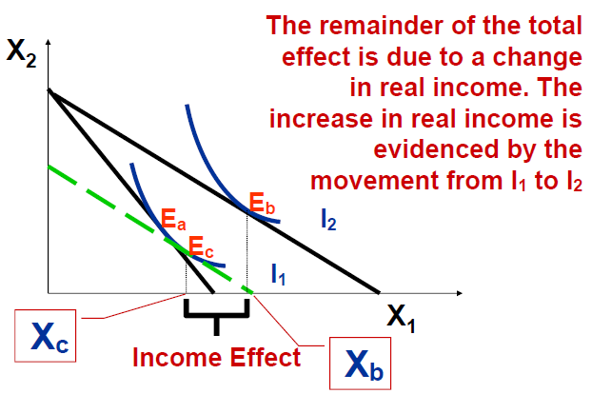

Slide 32
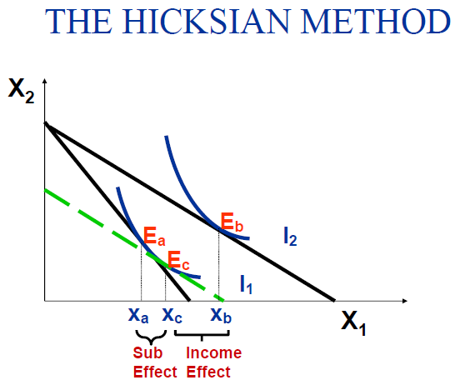

Slide 33
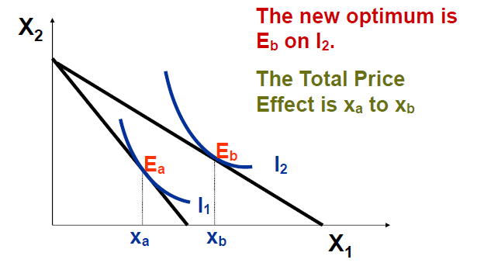
Slutsky Method of Decomposition
Optimal bundle is Ea, on indifference curve I₁.
A fall in the price of X_{1,} The budget line pivots out from P.
The new optimum is Eb on I₂.

Slide 34
THE SLUTSKY METHOD
At the new prices,
– less income is needed to buy the original bundle then “real income” has increased
– more income is needed to buy the original bundle then “real income” has decreased
Isolate the change in demand due only to the change in relative prices by asking “What is the change in demand when the consumer’s income is adjusted so that, at the new prices, s/he can just afford to buy the original bundle?”

Slide 35
THE SLUTSKY METHOD
To isolate the substitution effect the consumer’s money income is adjusted so that s/he change can just afford the original consumption bundle.
In other words purchasing power is held constant.

Slide 36
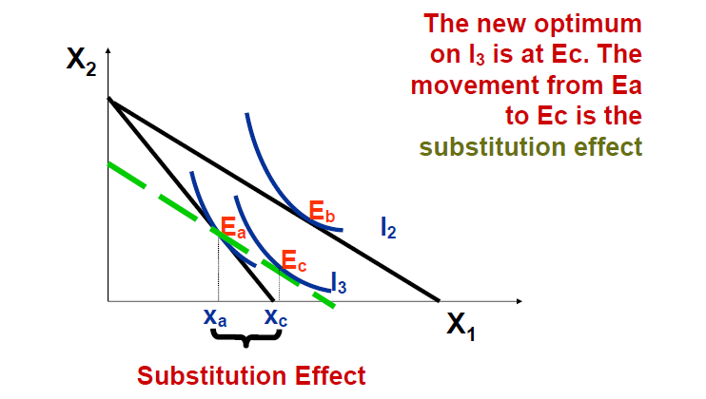
Draw a line parallel to the new budget line which passes through the point Ea. I₃ is tangent to this new budget line at E_{C.} Total Price effect is from Ea to Eb. Income effect Ec to Eb =

Slide 37
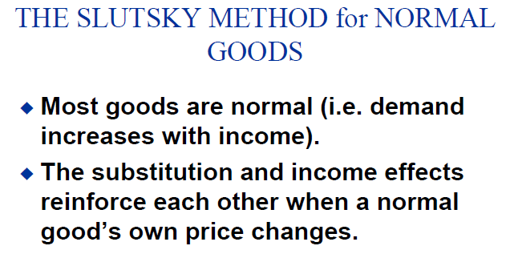

Slide 38
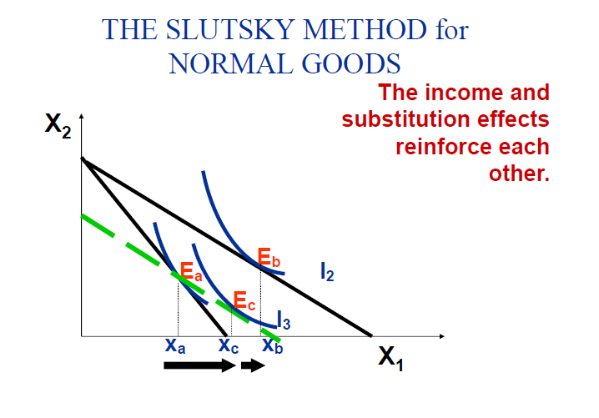

Slide 39
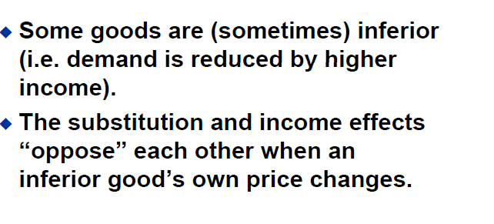
Inferior Goods

Slide 40
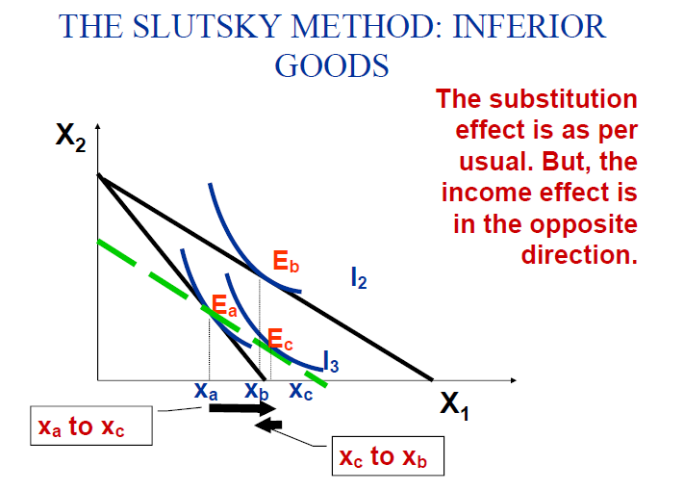

Slide 41
Giffen Goods
Alfred Marshall (1949) described the case of upward sloping demand curve and gave the credit for this idea to Robert Giffen. If the negative income effect of a fall in price of a good is larger than the positive substitution effect, demand curve for such a good will be upward sloping.

Slide 42
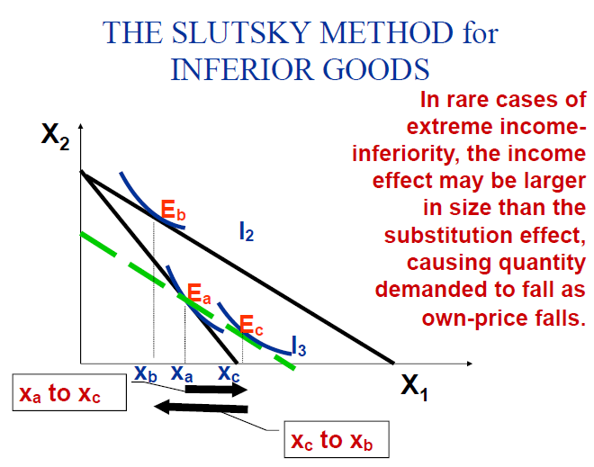
GIFFEN GOODS

Slide 43
Effect of a decline in price of a good.
Type of good | Substitution effect | Income Effect | Price effect
Normal | Positive | positive | positive
Inferior | positive | negative | positive
Giffen | positive | negative | negative

